Slide 1
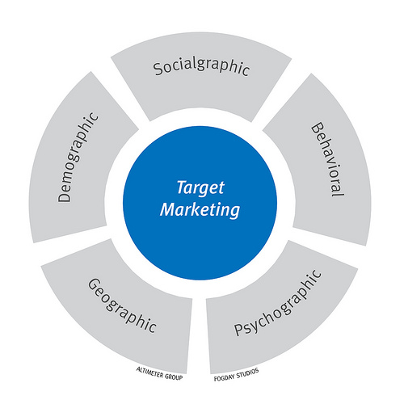
Identify Target Market
Advertising and Public Relations > The Advertising Campaign
Target markets are groups of individuals separated by distinguishable and noticeable characteristics.
A company may have identified its target market, but selling its product may entail identifying even smaller, better defined target groups.
A target audience and a target market can be formed of people of a certain age group, gender, or marital status.
Target Market
View on Boundless.com
Free to share, print, make copies and changes. Get yours at www.boundless.com
www.boundless.com/marketing/textbooks/boundless-marketing-textbook/advertising-and-public-relations-13/the-advertising-campaign-88/identify-target-market-436-4153

Slide 2
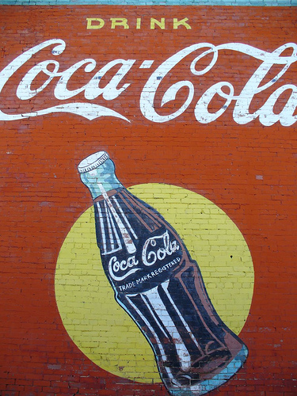
Informative, Persuasive and Reminder Advertising
Advertising and Public Relations > The Advertising Campaign
Reminder advertising reinforces previous promotional activity by keeping the name of good, service, person, or cause before the public.
Marketers use persuasive advertising to increase the demand for an existing good, service, or organization.
Informative advertising is often used when launching a new product or for an updated or relaunched product.
Coca-Cola
View on Boundless.com
Free to share, print, make copies and changes. Get yours at www.boundless.com
www.boundless.com/marketing/textbooks/boundless-marketing-textbook/advertising-and-public-relations-13/the-advertising-campaign-88/informative-persuasive-and-reminder-advertising-438-219

Slide 3
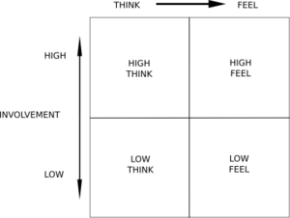
Advertising and Public Relations
The FCB Grid
With this model, messages are categorized by "thinking" and "feeling", "low" and "high".
Free to share, print, make copies and changes. Get yours at www.boundless.com
Wikibooks. "Advertising/Strategies." CC BY-SA 3.0 http://en.wikibooks.org/wiki/Advertising/Strategies#GE_Focus_System View on Boundless.com

Slide 4
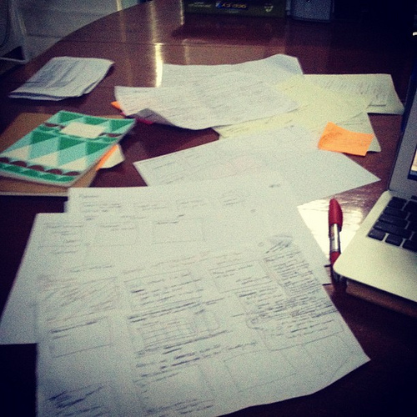
Advertising and Public Relations
The Creative Process
Once all of the relevant facts have been obtained, one can start creating the ad.
Free to share, print, make copies and changes. Get yours at www.boundless.com
Flickr. "Emerging from the Frankenstein stage of the creative process for a #SocialMedia Strategy presentation :) | Flickr - Photo Sharing!." CC BY http://www.flickr.com/photos/samanthabell/6840295551/ View on Boundless.com

Slide 5
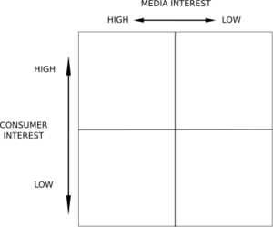
Advertising and Public Relations
The Harris Grid
The Harris Grid measures a product's level of interest in consumers versus the level of interest in mass media.
Free to share, print, make copies and changes. Get yours at www.boundless.com
Wikibooks. "Advertising/Strategies." CC BY-SA 3.0 http://en.wikibooks.org/wiki/Advertising/Strategies#GE_Focus_System View on Boundless.com

Slide 6
Advertising and Public Relations
Coca-Cola
Coca-Cola is an established brand which uses reminder advertising.
Free to share, print, make copies and changes. Get yours at www.boundless.com
Flickr. "Coca-Cola Mural | Flickr - Photo Sharing!." CC BY http://www.flickr.com/photos/kb35/349761636/ View on Boundless.com

Slide 7
Advertising and Public Relations
Target Market
A target market is a group of customers that the business has decided to aim its marketing efforts and ultimately its merchandise toward.A well-defined target market is the first element to a marketing strategy.
Free to share, print, make copies and changes. Get yours at www.boundless.com
Flickr. "Target Marketing | Flickr - Photo Sharing!." CC BY-SA http://www.flickr.com/photos/fogfish/4404265071/ View on Boundless.com

Slide 8
Advertising and Public Relations
Advertising is considered effective when it communicates that the product is _________.
A) Priced low enough to sell.
B) Available in many different retail outlets.
C) Will appeal to a certain target market.
D) Different and better than the competition
Free to share, print, make copies and changes. Get yours at www.boundless.com

Slide 9
Advertising and Public Relations
Advertising is considered effective when it communicates that the product is _________.
A) Priced low enough to sell.
B) Available in many different retail outlets.
C) Will appeal to a certain target market.
D) Different and better than the competition
Free to share, print, make copies and changes. Get yours at www.boundless.com
Boundless - LO. "Boundless." CC BY-SA 3.0 http://www.boundless.com/

