Slide 1
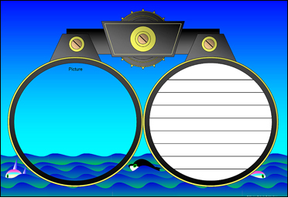
Annotating
Text to Deepen Understanding
Doug Fisher
and
Nancy Frey

Slide 2

Annotation is a note of any form made while reading text.
“Reading with a pencil.”

Slide 3


People have been annotating texts since there have been texts to annotate.

Slide 4

Annotation is not highlighting.

Slide 5

Annotation slows down the reader in order to deepen understanding.

Slide 6
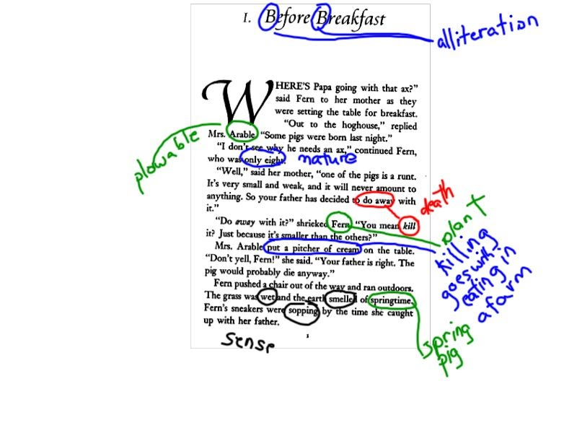
Middle school student’s annotation of connotative meanings in Charlotte’s Web
Notes:
It’s not always about reading difficult texts, but also about reading seemingly simpler texts in more complex ways.

Slide 7

Annotation occurs with digital and print texts.

Slide 8
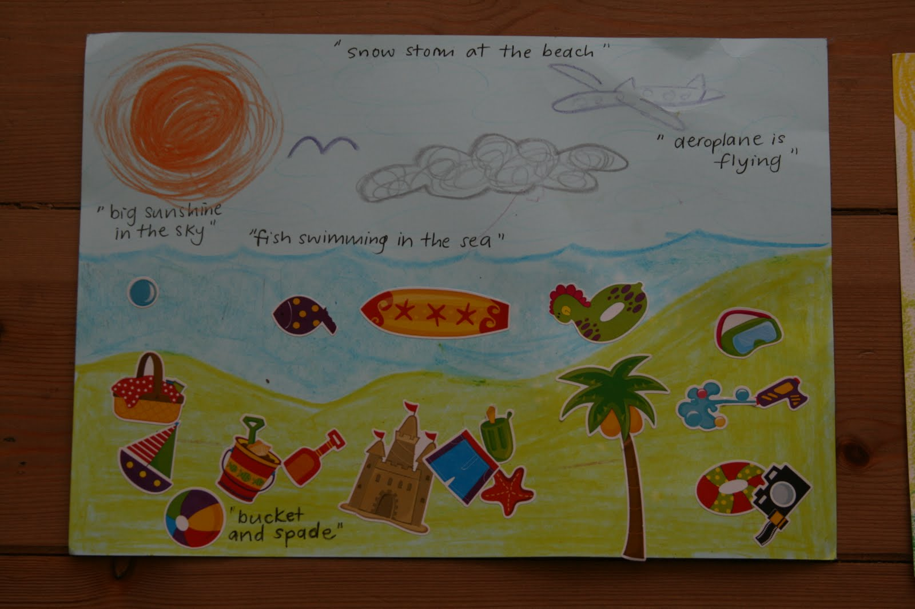
Annotation in PreK-2
Language experience approach
Interactive writing and shared pen activities

Slide 9
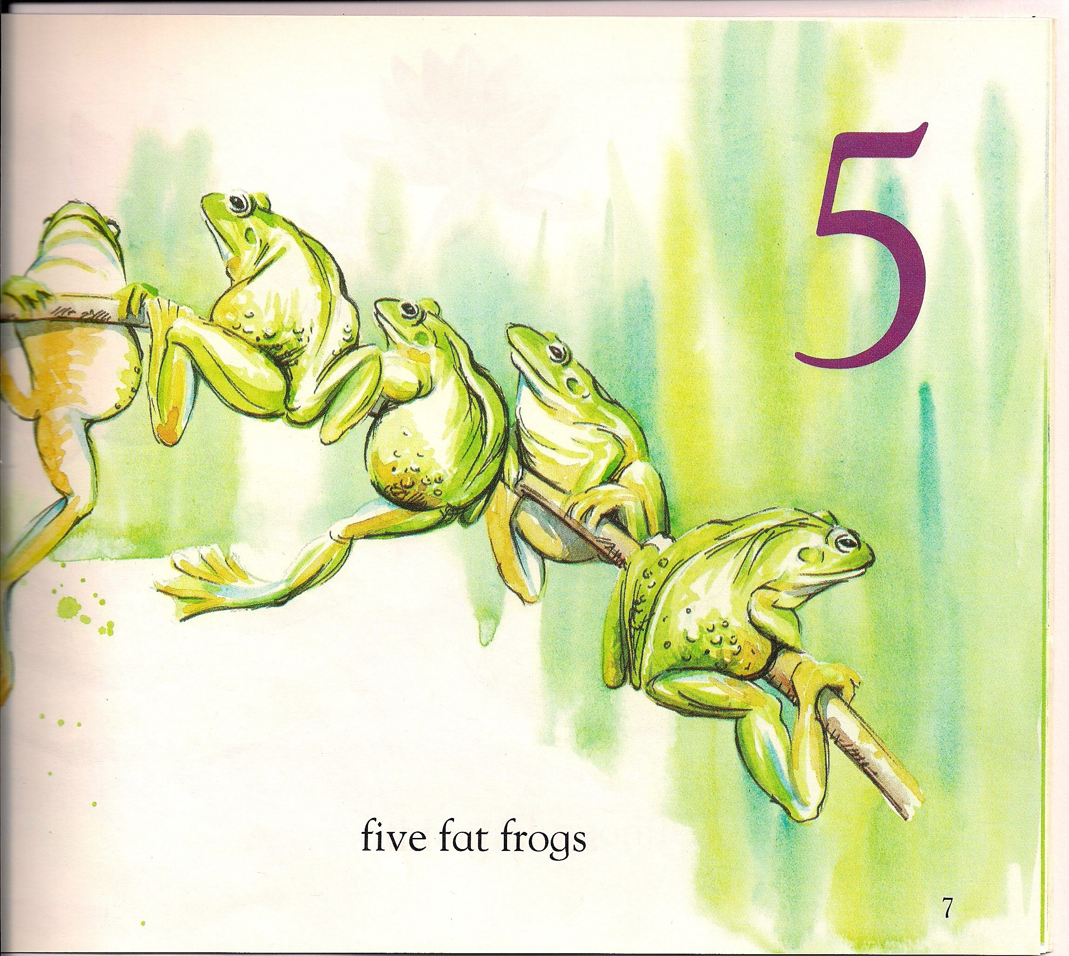
1
2
3
4
5
Modeled Annotation in Kindergarten
Kemp, L. M. (1996). One peaceful pond: A counting book. New York: Houghton Mifflin.

Slide 10
Modeled Annotation in Second
Harvey, S., & Goudvis, A. (2007). Strategies That Work: Teaching Comprehension for Understanding and Engagement. Portland, ME: Stenhouse.

Slide 11
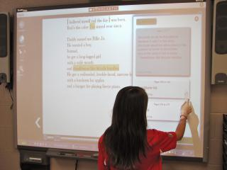
Even young students can annotate.

Slide 12
Annotations in Grades 3-5
Underline the major points.
Circle keywords or phrases that are confusing or unknown to you.
Use a question mark (?) for questions that you have during the reading. Be sure to write your question.

Slide 13
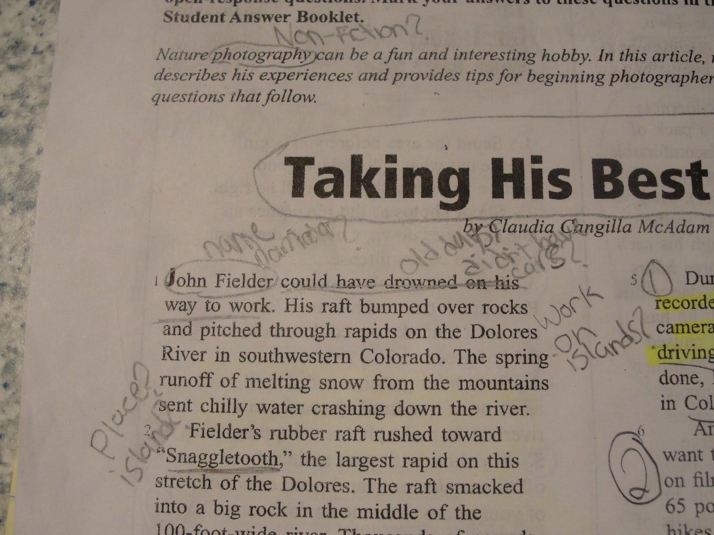
Using
Questioning
in Fifth Grade

Slide 14
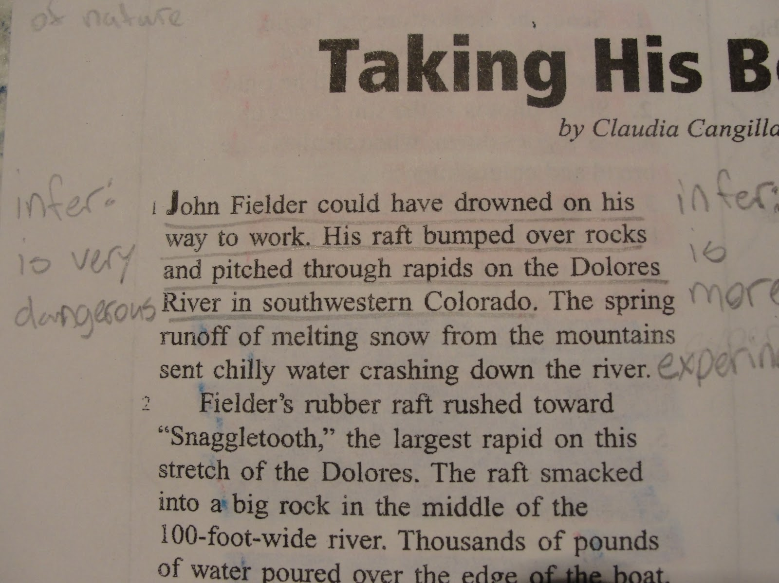
Same text, different student, different strategy: Inferring.

Slide 15
Annotation in Grades 6-8
Underline the major points.
Circle keywords or phrases that are confusing or unknown to you.
Use a question mark (?) for questions that you have during the reading. Be sure to write your question.
Use an exclamation mark (!) for things that surprise you, and briefly note what it was that caught your attention.
Draw an arrow (↵) when you make a connection to something inside the text, or to an idea or experience outside the text. Briefly note your connections.

Slide 16
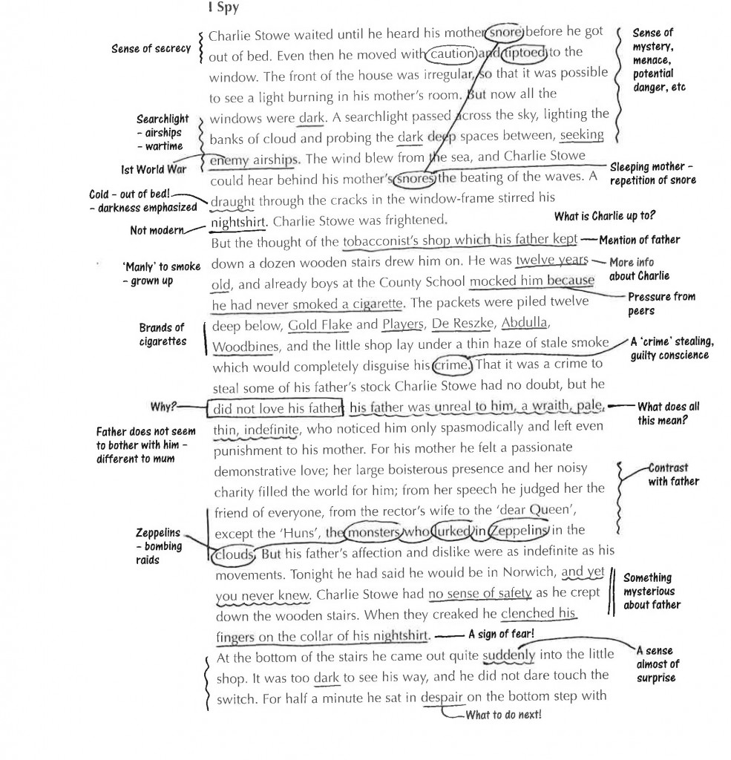
Modeled annotation in Seventh Grade

Slide 17
Annotation in Grades 9-12
Underline the major points.
Circle keywords or phrases that are confusing or unknown to you.
Use a question mark (?) for questions that you have during the reading. Be sure to write your question.
Use an exclamation mark (!) for things that surprise you, and briefly note what it was that caught your attention.
Draw an arrow (↵) when you make a connection to something inside the text, or to an idea or experience outside the text. Briefly note your connections.
Mark EX when the author provides an example.
Numerate arguments, important ideas, or key details and write words or phrases that restate them.

Slide 18
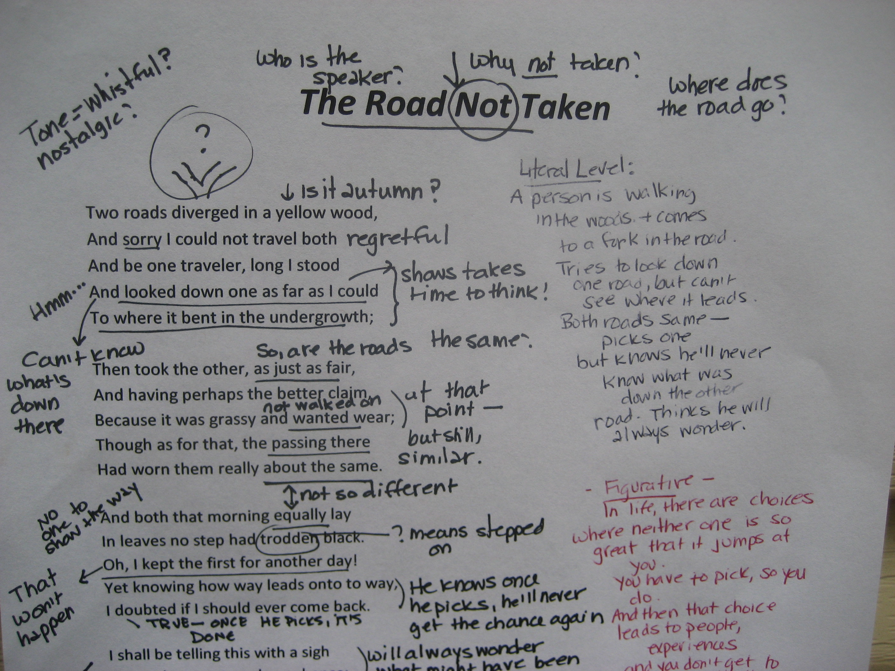
Modeling in 9th Grade English

Slide 19
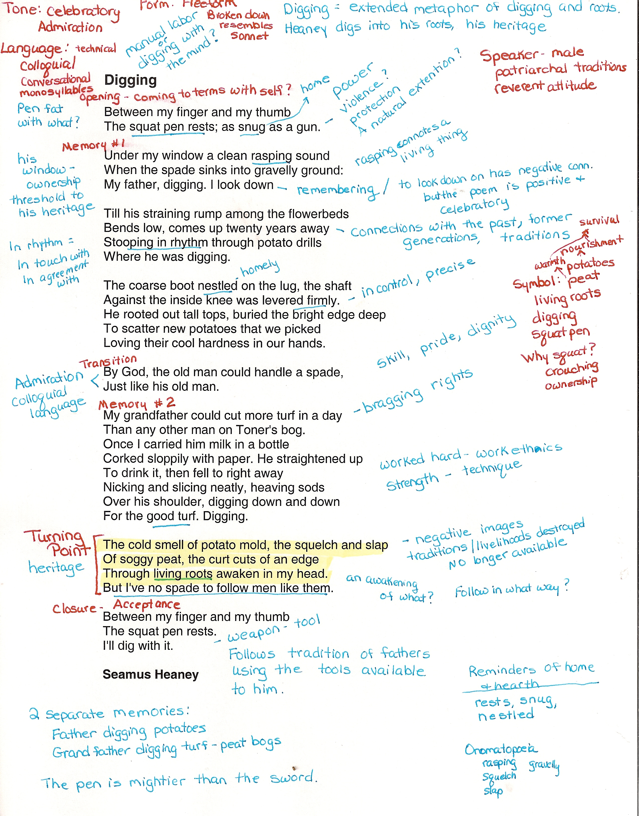
Student annotation in 11th grade English

Slide 20

If you want to teach effective annotation, begin with the purpose.
https://www.teachingchannel.org/videos/student-annotated-reading-strategy

Slide 21
Teach them a notation
system appropriate for your content area

